Slide 1
BASES FOR COMPARISON OF ALTERNATIVES CONTD.
ANNUAL EQUIVALENT METHOD
In the annual equivalent method of comparison, first the annual equivalent cost or the revenue of each alternative will be computed.
Then the alternative with the maximum annual equivalent revenue in the case of revenue-based comparison or with the minimum annual equivalent cost in the case of cost- based comparison will be selected as the best alternative.

Slide 2
EXAMPLE
A company provides a car to its chief executive. The owner of the company is concerned about the increasing cost of petrol. The cost per litre of petrol for the first year of operation is N21. He feels that the cost of petrol will be increasing by N1 every year. His experience with his company car indicates that it averages 9 km per litre of petrol. The executive expects to drive an average of 20,000 km each year for the next four years. What is the annual equivalent cost of fuel over this period of time?. If he is offered similar service with the same quality on rental basis at N60,000 per year, should the owner continue to provide company car for his executive or alternatively provide a rental car to his executive? Assume i = 18%. If the rental car is preferred, then the company car will find some other use within the company.

Slide 3
Solution
Average number of km run/year = 20,000 km
Number of km/litre of petrol = 9 km
Therefore,
Petrol consumption/year = 20,000/9 = 2222.2 litre
Cost/litre of petrol for the 1st year = N21
Cost/litre of petrol for the 2nd year = N 21.00 + N 1.00 = N 22.00
Cost/litre of petrol for the 3rd year = N 22.00 + N1.00 = N23.00
Cost/litre of petrol for the 4th year = N 23.00 + N1.00 = N24.00

Slide 4
Fuel expenditure for 1st year = 2222.2 x 21 = N46,666.20
Fuel expenditure for 2nd year = 2222.2 x 22 = N48,888.40 (N46,666.20 + 2222.2)
Fuel expenditure for 3rd year = 2222.2 x 23 = N51,110.60 (N46,666.20 + 2222.2 + 2222.2)
Fuel expenditure for 4th year = 2222.2 x 24 = N53,332.80 (N46,666.20 + 2222.2 + 2222.2+ 2222.2)
The annual equal increment of the above expenditures is N2,222.20 (G). The cash flow diagram for this situation is depicted below:

Slide 5
Uniform gradient series cash flow diagram

Slide 6
A1 = N46,666.20 and G = N2,222.20
A = A1 + G(A/G, 18%, 4)
= 46,666.20 + 2222.2(1.2947)
= N49,543.28
The proposal of using the company car by spending for petrol by the company will cost an annual equivalent amount of N49,543.28 for four years. This amount is less than the annual rental value of N60,000. Therefore, the company should continue to provide its own car to its executive.
Hint:

Slide 7
RATE OF RETURN METHOD
The rate of return of a cash flow pattern is the interest rate at which the present worth of that cash flow pattern reduces to zero.
In this method of comparison, the rate of return for each alternative is computed. Then the alternative which has the highest rate of return is selected as the best alternative.
EXAMPLE
Akogun is planning a new business. The initial outlay and cash flow pattern for the new business are as listed below. The expected life of the business is five years. Find the rate of return for the new business.

Slide 8
Solution
Initial investment = N100,000
Annual equal revenue = N30,000
Life = 5 years
The cash flow diagram for this situation is illustrated in the Figure below:
100,000
The present worth function for the business is
PW(i) = –100,000 + 30,000(P/A, i, 5)

Slide 9
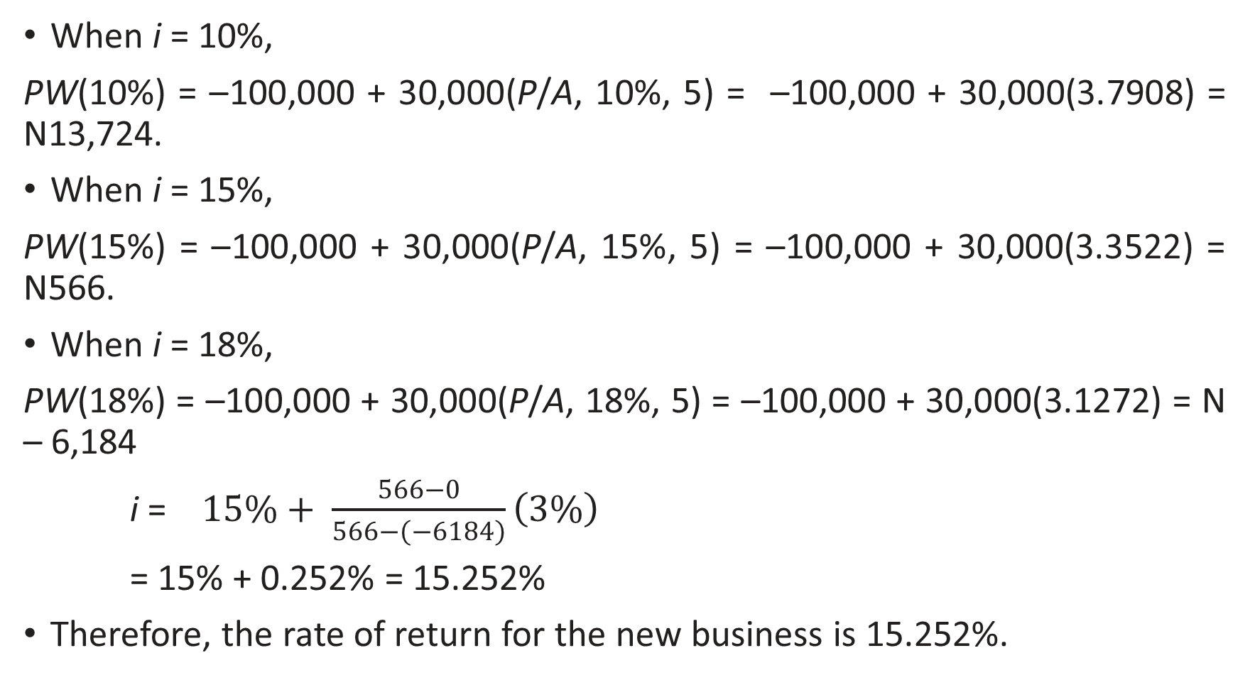
When i = 10%,
PW(10%) = –100,000 + 30,000(P/A, 10%, 5) = –100,000 + 30,000(3.7908) = N13,724.
When i = 15%,
PW(15%) = –100,000 + 30,000(P/A, 15%, 5) = –100,000 + 30,000(3.3522) = N566.
When i = 18%,
PW(18%) = –100,000 + 30,000(P/A, 18%, 5) = –100,000 + 30,000(3.1272) = N – 6,184
i = $15\%+ \frac{566−0}{566−\left(−6184\right)}\left(3\%\right)$
= 15% + 0.252% = 15.252%
Therefore, the rate of return for the new business is 15.252%.

Slide 10
REPLACEMENT AND MAINTENANCE ANALYSIS
Home work
A firm is considering replacement of an equipment, whose first cost is N40m and the scrap value is negligible at the end of any year. Based on experience, it was found that the maintenance cost is zero during the first year and it increases by N2m every year thereafter.
(a) When should the equipment be replaced if i = 0%?
(b) When should the equipment be replaced if i = 12%?

Slide 11
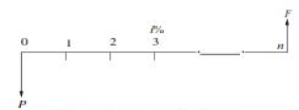
REPLACEMENT OF EXISTING ASSET WITH A NEW ASSET
Capital Recovery with Return
Consider the following data of a machine. Let
P = purchase price of the machine,
F = salvage value of the machine at the end of machine life,
n = life of the machine in years, and
i = interest rate, compounded annually
The equation for the annual equivalent amount for the cash flow diagram is
AE(i) = (P – F) (A/P, i, n) + F i
This equation represents the capital recovery with return.

Slide 12
Concept of Challenger and Defender
If an existing equipment is considered for replacement with a new equipment, then the existing equipment is known as the defender and the new equipment is known as challenger.
Assume that an equipment has been purchased about three years back for N5,000,000 and it is considered for replacement with a new equipment. The supplier of the new equipment will take the old one for some money, say, N3,000,000.
This should be treated as the present value of the existing equipment and it should be considered for all further economic analysis.
The purchase value of the existing equipment before three years is now known as sunk cost, and it should not be considered for further analysis.

Slide 13
EXAMPLE
Two years ago, a machine was purchased at a cost of N200,000 to be useful for eight years. Its salvage value at the end of its life is N25,000. The annual maintenance cost is N25,000. The market value of the present machine is N120,000. Now, a new machine to cater to the need of the present machine is available at N150,000 to be useful for six years. Its annual maintenance cost is N14,000. The salvage value of the new machine is N20,000. Using an interest rate of 12%, find whether it is worth replacing the present machine with the new machine.

Slide 14
Solution
Alternative 1— Present machine
Purchase price = N200,000
Present value (P) = N120,000
Salvage value (F) = N25,000
Annual maintenance cost (A) = N25,000
Remaining life = 6 years
Interest rate = 12%
The cash flow diagram of the present machine is illustrated in
120,000
200,000

Slide 15
annual maintenance cost for the preceding periods are not shown in this figure. The annual equivalent cost is computed as
AE(12%) = (P – F)(A/P, 12%, 6) + F i + A
= (120,000 – 25,000)(0.2432) + 25,000 *0.12 + 25,000
= N51,104
Alternative 2— New machine
Purchase price (P) = N150,000
Salvage value (F) = N20,000
Annual maintenance cost (A) = N14,000
Life = 6 years
Interest rate = 12%
The cash flow diagram of the new machine is depicted in the figure below

Slide 16
150,000

Slide 17
The formula for the annual equivalent cost is
AE(12%) = (P – F)(A/P, 12%, 6) + F*i + A
= (150,000 – 20,000)(0.2432) + 20,000* 0.12 + 14,000
= N48,016
Since the annual equivalent cost of the new machine is less than that of the present machine, it is suggested that the present machine be replaced with the new machine.

Slide 18
DEPRECIATION
Any equipment which is purchased today will not work for ever. This may be due to wear and tear of the equipment or obsolescence of technology.
Hence, it is to be replaced at the proper time for continuance of any business.
The replacement of the equipment at the end of its life involves money. This must be internally generated from the earnings of the equipment.
The recovery of money from the earnings of an equipment for its replacement purpose is called depreciation fund since we make an assumption that the value of the equipment decreases with the passage of time.
Thus the word “depreciation” means decrease in value of any physical asset with the passage of time.

Slide 19
Methods of Depreciation
1. Straight line method of depreciation
2. Declining balance method of depreciation
3. Sum of the years—digits method of depreciation
4. Sinking-fund method of depreciation
5. Service output method of depreciation

Slide 20
Straight Line Method of Depreciation
In this method of depreciation, a fixed sum is charged as the depreciation amount throughout the lifetime of an asset such that the accumulated sum at the end of the life of the asset is exactly equal to the purchase value of the asset. (Note* Here, we make an important assumption that inflation is absent)
Let
P = first cost of the asset,
F = salvage value of the asset
n = life of the asset,
Bt = book value of the asset at the end of the period t,
Dt = depreciation amount for the period t.
The formulae for depreciation and book value are as follows:

Slide 21
CLASS TEST 1

Slide 22
Question 1: Consider the following two mutually exclusive alternatives:
At i = 15%, select the best alternative based on future
Question 2: The demand for a product rises from 500 units to 600 units where the price of a particular product reduces from N25,000 to N22,000. Find the cross elasticity of demand for the two products. What is the nature of their relationship?
Alternative | 0 | End of year
 |  | 1 | 2 | 3 | 4
A (N) | -5,000,000 | 2,000,000 | 2,000,000 | 2,000,000 | 2,000,000
B (N) | -4,500,000 | 1,800,000 | 1,800,000 | 1,800,000 | 1,800,000

Slide 23
Question 3: (Design selection for a process industry). The chief engineer of refinery operations is not satisfied with the preliminary design for storage tanks to be used as part of a plant expansion programm. The engineer who submitted the design was called in and asked to reconsider the overall dimensions in the light of an article in the Chemical Engineer, entitled “How to size future process vessels?” The original design submitted called for 4 tanks 5.2 m in diameter and 7 m in height. From a graph of the article, the engineer found that the present ratio of height to diameter of 1.35 is 111% of the minimum cost and that the minimum cost for a tank was when the ratio of height to diameter was 4 : 1. The cost for the tank design as originally submitted was estimated to be N900,000. What are the optimum tank dimensions if the volume remains the same as for the original design? What total savings may be expected through the redesign?

